Slide 1
OPEN presentation, October 2017 Dr Gemma McKibbin & Dr Nick Halfpenny
Preventing Harmful Sexual Behaviour and Child Sexual Exploitation for children & young people living in residential care: A scoping review

Slide 2
Acknowledgement
Acknowledging the traditional owners of the land
Acknowledging victims of child sexual abuse

Slide 3
Context for the project
Royal Commission into Institutional Responses to Child Sexual Abuse
Consultation Paper: Institutional responses to child sexual abuse in out-of-home care. Commonwealth of Australia, Sydney (2016).
Bromfield, L., Hirte, C., Octoman, O., Katz, I. (2017). Child Sexual Abuse in Australian Institutional Contexts 2008–13: Findings from Administrative Data. Sydney: Royal Commission into Institutional Responses to Child Sexual Abuse.
Commission for Children and Young People
‘As a good parent would’: Inquiry into the adequacy of the provision of residential care services to Victorian children & young people who have been subject to sexual abuse or sexual exploitation whilst residing in residential care. Melbourne, Victoria (2015).

Slide 4
Key themes
Growing awareness of the sexual exploitation of young people in out-of-home care and accompanying prevalence data
Evidence that a substantial proportion individuals identified as perpetrating child sexual abuse were themselves children or young people
Limited rigorous research evidence on the effectiveness of practices and programs aimed at preventing sexual abuse in out-of-home care
Acknowledging that children in out-of-home care may miss out universal prevention initiatives (e.g. curriculum delivered in schools – sexuality education, healthy and respectful relationships, social/emotional learning, child protections education)

Slide 5
Partnership seeding project - 2017
Aim
The aim of the action research is to co-design interventions to prevent and respond to harmful sexual behaviour and child sexual exploitation for children and young people living in residential care.
Research question
What prevention initiatives could prevent harmful sexual behaviour and sexual exploitation in residential care settings?
Methodology
This research question has been answered through the method set out by Graham and Tetroe (2009) called the Knowledge to Action Framework.

Slide 6
Five phases of seeding project
Establishment of Expert Advisory Group and Governance Group;
Ethics clearance from the Human Research Ethics Committee
Publishing Scoping Review of the evidence
Co-design of three initiatives through consultation
Tailoring strategies to three pilot houses
Including the voices of children & young people

Slide 7
Scoping review
Research question
What is known about preventing harmful sexual behavior and child sexual exploitation for children and young people living in residential out-of-home care settings?

Slide 8
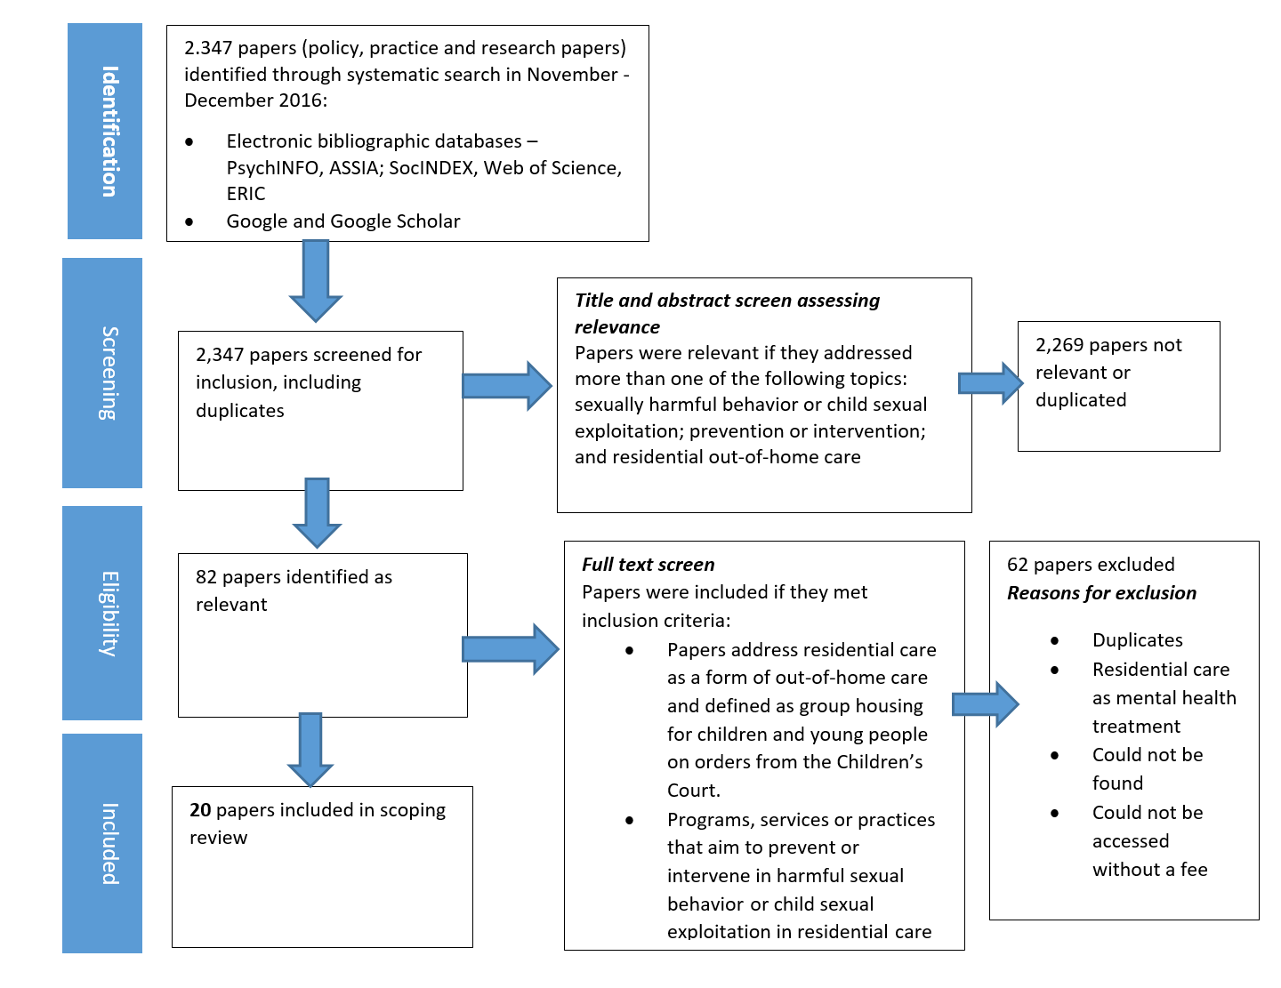
Scoping review

Slide 9
Papers included
The papers included:
seven peer-reviewed journal articles
three reports for government
two presentation transcripts; two literature reviews
one qualitative research report
one report for a government inquiry
one submission to a government inquiry
one consultation paper for a government inquiry
one guideline; and one educational resource
Nine of the papers were from the United Kingdom; seven were from Australia; two were from the United States; one was from Canada; and one was from the Netherlands.

Slide 10
Findings from scoping review
Three major thematic categories were identified through the coding:
1. Constructing educative interventions for children & young people
2. Targeting grooming and problematic sexual behaviour
3. Providing a holistic response and a way out

Slide 11
Public health model of prevention
Tertiary
Secondary
Primary

Slide 12
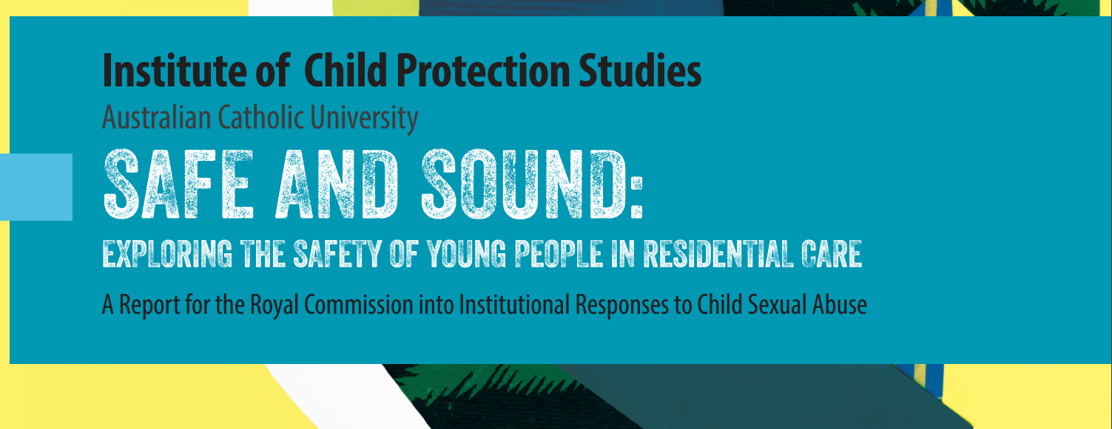
1. Constructing educative interventions for children & young people
1.1 Educating children & young people
1.2 Upskilling workers

Slide 13
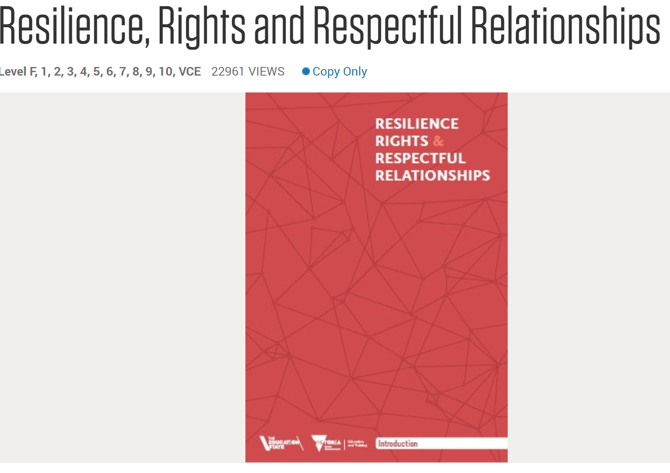

Slide 14
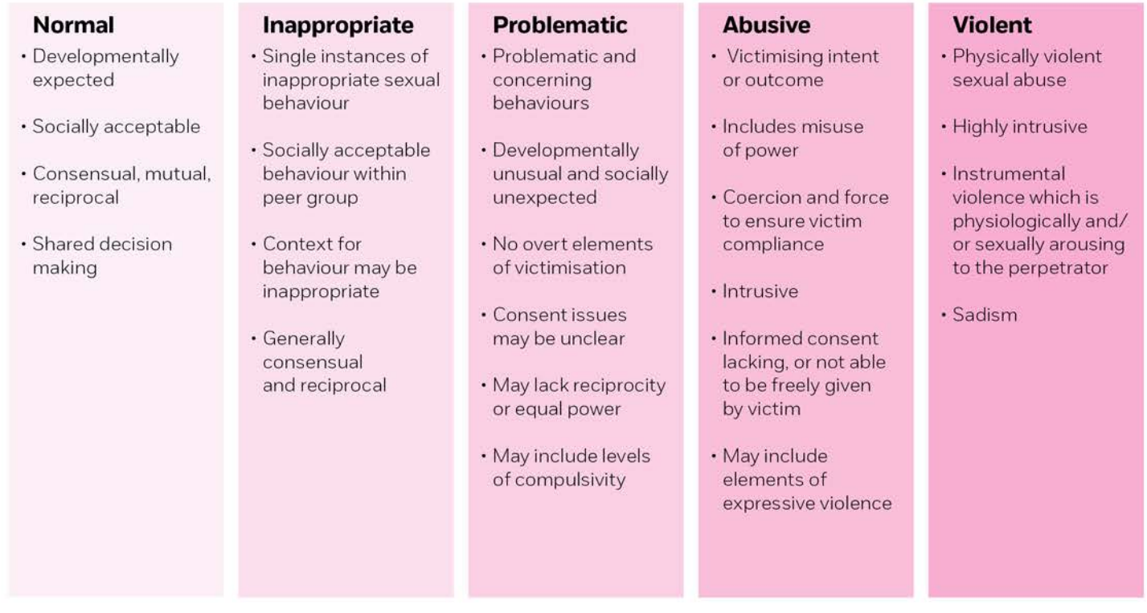

Slide 15
2. Targeting grooming and problematic sexual behaviour
2.1 Countering push and pull factors
2.2 Early recognition of problematic sexual behaviour

Slide 17
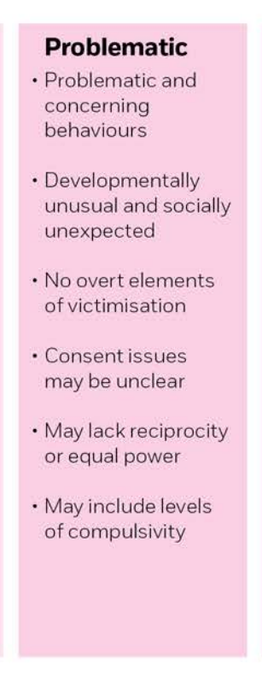

Slide 18
3. Providing a holistic response and a way out
3.1 Treatment, safety planning and placement management
3.2 Effective exit strategies and perpetrator accountability

Slide 19
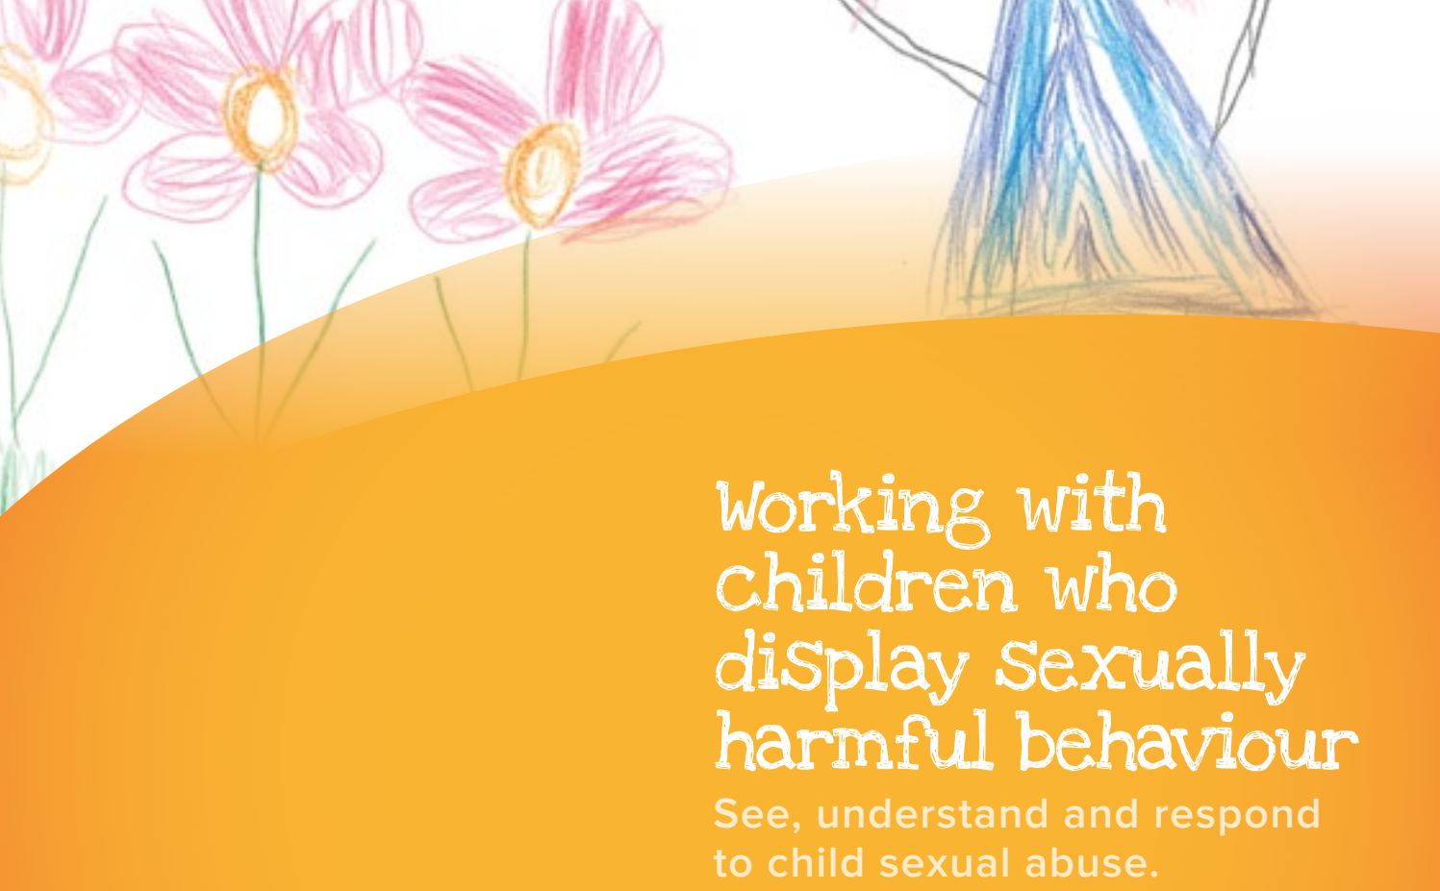

Slide 20
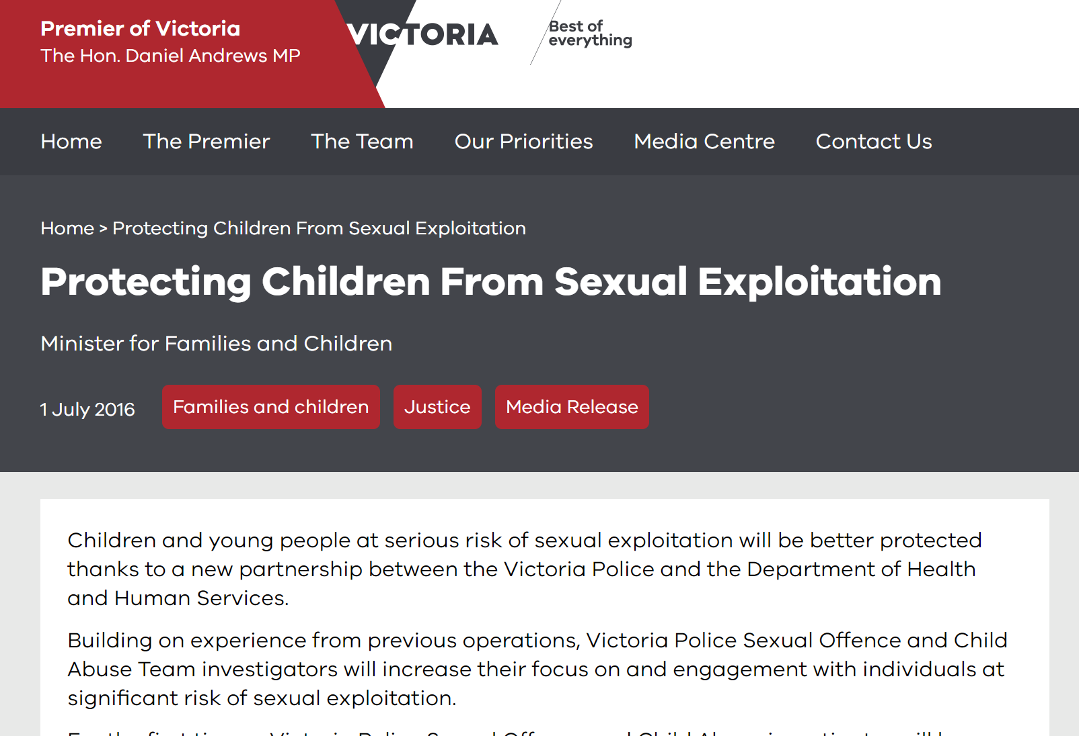

Slide 21
Three prevention strategies
 | Core components of three prevention strategies
Prevention strategy 1 – Whole-of-house respectful relationship and sexuality education | Train workers in recognising and responding to sexual health concerns, harmful sexual behaviour, child sexual exploitation and intimate partner violence (domestic & family violence) Educate children & young people about respectful relationships and sexual health & safety
Prevention strategy 2 – Sexual safety response | Provide wrap-around services to children & young people at risk of harmful sexual behaviour and child sexual exploitation Help workers join up their response with child sexual exploitation practice leaders, Sexually Abusive Behaviour Treatment Services, domestic & family violence services and Victoria Police
Prevention strategy 3 – Missing from home strategy | Establish practice partnerships between each child or young person and residential house workers (involving social media) to counter grooming Shadow and engage children & young people who leave the house Take out intervention orders on behalf of children & young people and to consistently share information with police as per the Enhanced Response Model
Notes:
.

Slide 22
Next step
Resource development
Development of training package
Design of implementation & evaluation

